Slide 1
Meeting Your Investment Need
Wuxi New District Presentation
Feb,14, 2012

Slide 2

Contents
About Wuxi City
About WND
WND, A Park of Value

Slide 3
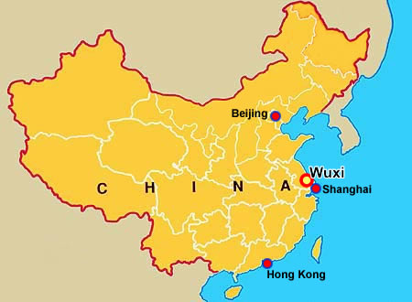
About Wuxi City
Location
Located in East China Economic Rim, Wuxi is known as a most important industrial city in China. It’s the birthplace of China national industry in history, and one of the focusing areas for international manufacturing in China ever since China’s opening up in 1970’s.

Slide 4
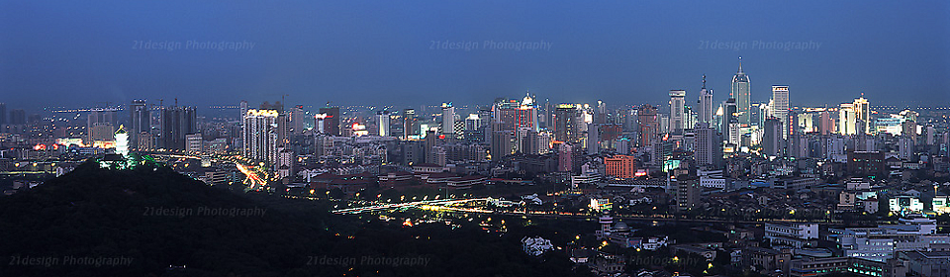


About Wuxi City
by 2010
GDP
financial revenue
GDP per capita
57.5
billion €
15.8 billion €
10,000 €
6.4 million
4,560sqkm

Slide 5
Thank you!
Wuxi New District Presentation
2012年2月13日

