Slide 1
Secure Endpoint
Andres Blanco Berkovics
SR Product Marketing Manager
Identity and Security Business
Microsoft Corporation
Tejas Mehta
SR Product Marketing Manager
Identity and Security Business
Microsoft Corporation

Slide 2
Business Needs And IT Challenges
Protect endpoints from advanced threats
Financially motivated
evolving threats
Enable secure access to resources from anywhere
Wide range of users
and devices
Protect sensitive data
on endpoints
Easily accessible sensitive data on multiple devices
Reduce security
management costs
Multiple vendors and complex management
BUSINESS Needs
IT Needs
Agility and Flexibility
Control

Slide 3
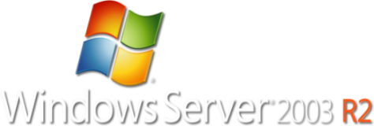



Windows Server 2008 R2
Release History
Windows Server 2008 R2
2003
2005
2008
2009

Slide 4



Business Ready Security
Help securely enable business by managing risk and empowering people
Protection
Access
Protect everywhere,
access anywhere
Identity
Integrate and extend
security across
the enterprise
Management
Highly Secure & Interoperable Platform
Simplify the security experience,
manage compliance
from:
to:
Block
Enable
Cost
Value
Siloed
Seamless

Slide 5

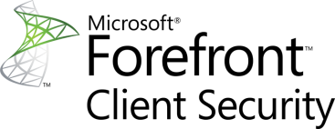



Business Ready Security Solutions
Secure Messaging
Secure Collaboration
Secure Endpoint
Information Protection
Identity and Access Management

Slide 6




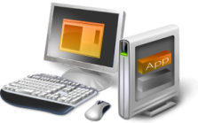

Secure Endpoint
Protect client and server operating systems from emerging threats and information loss, while enabling more secure access from virtually anywhere
PROTECT everywhere,
ACCESS anywhere
INTEGRATE and
EXTEND security
SIMPLIFY security,
MANAGE compliance
  Advanced malware protection
  Protect sensitive information
  Secure, always-on access
  Integrated with
  OS security
  Leverages existing infrastructure
  Simplified management
  Enterprise-wide visibility

Slide 7




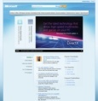






Advanced Protection Against Web-based Exploits
Protect everywhere,
access anywhere
Advanced URL filtering for safe
web browsing
Reputation services for enhanced accuracy
Integrated Anti-Malware protection at
the edge
Inspects encrypted and unencrypted
web traffic
Prevents exploits against browser-based vulnerabilities
PHISHING / MALWARE SITES
VIRUSES / SPYWARE
SAFE TRAFFIC
URL
FILTERING
“
MANAGED /
UN-MANAGED
TMG will include scanning for malware and inappropriate content, enabling them to be eliminated before they enter an organization's network. It will also incorporate sophisticated URL filtering technology to help block access to inappropriate or dangerous Web sites.
Don Retallack, Security Analyst at Directions on Microsoft in Redmond Channel Partner, June 2009

Slide 8





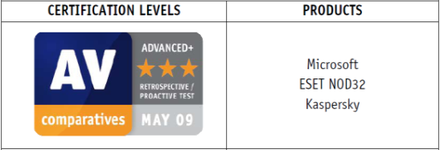
Comprehensive Malware Protection For Endpoints
Protect everywhere,
access anywhere
Integrated anti-virus/anti-spyware
agent for real-time protection
Advanced detection technologies
for complex malware
Unique vulnerability assessments
Rapid response through global
threat research team
Malicious Threats
Management Console
      Top ranked Anti-Malware engine in proactive detection
      Microsoft beat Symantec, McAfee, and 13 other competitors.
      —AV-Comparatives (May 2009)

Slide 9
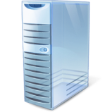













Provide More Secure, Anywhere Access
Protect everywhere,
access anywhere
Seamless, always-on connectivity
Policy-based network access
Consolidated secure portal for
easy remote access to resources
Simplified sign-on
TRUSTED
DIRECT ACCESS
ON-PREMISES
SSL VPN
SSL VPN
EXTERNAL (trusted)
EXTERNAL (un-trusted)
“
Using Intelligent Application Gateway, employees can connect easily, which means that our important customer information is accessible for them wherever they are.
-- Raymond Provily, Manager of Facilities

Slide 10






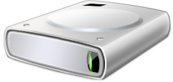



Secure Sensitive Information
Protect everywhere,
access anywhere
Access policy for removable media
Reduce information loss risk through integrated drive encryption
Classify and protect information with
built-in AD RMS
“
Device Control
BitLocker
Because of the critical nature of the information we manage, we needed a system that offered the ultimate protection. Forefront and Vista BitLocker combined really make us more secure than ever before.
John Rodgers, Director of Technical Infrastructure Support
Source: Customs Service Improves Reporting with Simplified, Integrated Antivirus Solution. Microsoft case study, April 2007. http://www.microsoft.com/casestudies/Case_Study_Detail.aspx?CaseStudyID=201402

Slide 11


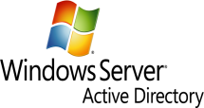




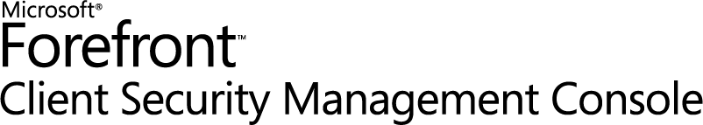

Leverage Existing Infrastructure
Integrate and extend
security
Integration with
Existing Infrastructure
Automated Deployment Compliance-based Access
Update Services
Integrated Solution
“
  Forefront Client Security works seamlessly with our core infrastructure components. As a result, we have reduced the cost of administering our security infrastructure by 60 percent.
  —Thomas Thiew, IT Manager, PhillipCapital

Slide 12

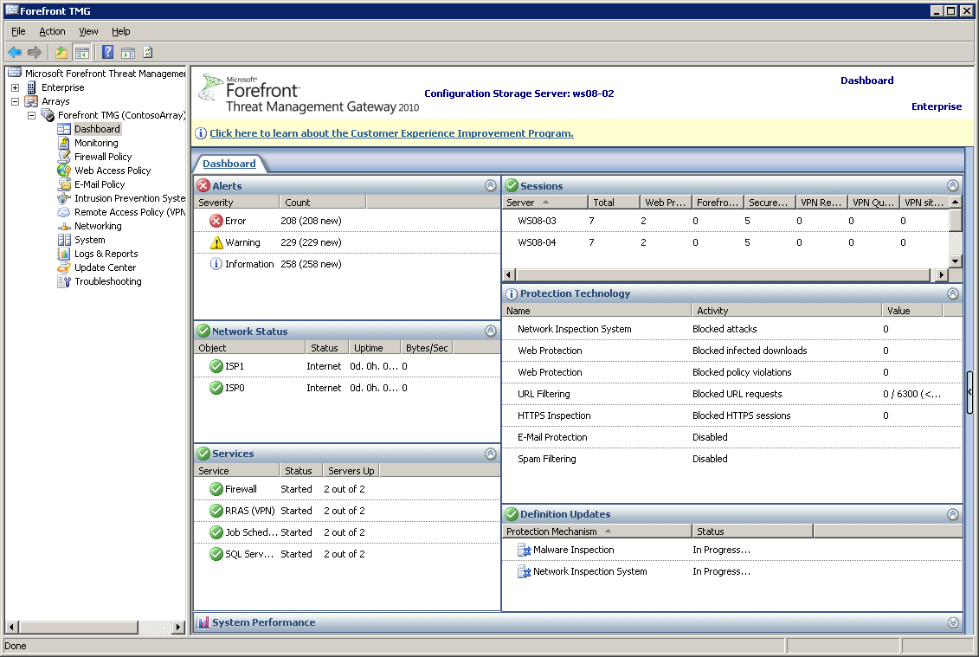

Simplify Security Management
Simplify security,
manage compliance
Easy-to-use wizards for security and policy configuration
Enterprise-wide client
state visibility
Insightful reports to
ensure compliance
“
  Forefront Client Security gives us the ability to easily manage our IT environment in a centralized way while giving us full reporting on the security of the entire Windows infrastructure.
  —Dan See, Director of Infrastructure, FranklinCovey

Slide 13






Current Situation
Increased risk from evolving threats
Reactive Security
Susceptible to vulnerabilities
No compliance checks
MALICIOUS THREATS
Multiple Vendors
Complex Tools
Limited Access to resources
Threats
from Unmanaged Endpoints
INFORMATION LOSS
REMOTE ACCESS
Lack of comprehensive
data protection
No policy for removable device

Slide 14









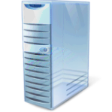




Secure Endpoint Solution
MULTI-LAYERED ANTI-MALWARE
PROTECTION
Integrated Information Protection
Forefront scans for viruses
DIRECT ACCESS
INFORMATION PROTECTION
SECURE REMOTE ACCESS

Slide 16
www.51pptmoban.com 搜集整理
Notes:
PRB-TDM Powerpoint template
5/22/2012 11:11 AM
16

Slide 17



Customer Testimonial
Allina Hospitals & Clinics
Healthcare Company Simplifies Management, Boosts Protection with New Security Solution
BUSINESS SITUATION
SOLUTION
BENEFITS PROVIDED
  Improving protection of critical systems
  Integrating a security solution with the IT environment
  Improving reporting capabilities
  Simplified and centralized management
  Improved integration
  with the existing IT environment
  Increased IT visibility
  Improved and
  unified protection
Management Consoles
“
When we first deployed Forefront Client Security, we discovered that we had at least four times as many infections as we thought. Since then, we have seen a downward trend in the number of computers infected.
Andrew Julian, Lead Operating Systems Programmer
Source: Secure Collaboration for Aerospace and Defense Firms. Microsoft case study, April 2009. http://www.microsoft.com/casestudies/Case_Study_Detail.aspx?CaseStudyID=4000003996

Slide 18
PROTECT Everywhere
ACCESS Anywhere

Slide 19



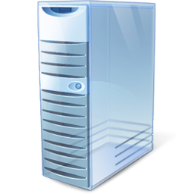

Unified Malware Protection
Protect everywhere,
access anywhere
  Engine Detection and Removal Capabilities
  One solution for spyware and virus protection
  Real-time detection using Microsoft® Windows® Filter Manager technology
  Assurance that system is fully functional after cleaning
  Comprehensive Antivirus/Anti-Spyware Protection
  Single scanning agent to enhance client machine performance
  On-access protection via kernel mode mini-filter
Management Console
  Behavior
  analysis
  Heuristic
  detection
Antivirus /
worms
  Anti-
  spyware
  User-mode
  rootkit scanning
Malicious Threats

Slide 20



Scan Mechanism
Protect everywhere,
access anywhere
  Real-time, scheduled, and on-demand detection and removal
  Minimal end-user disruptions using Filter Manager
  Scans for rootkits
  Behavior analysis for polymorphic viruses
  Scans for dozens of archives and packers
  Quick scan in-memory processes
  On-Demand Scan
  Schedule Scan
Security Administrator
Management Console
  Real-Time Scan

Slide 21






Protection from Web-Based Threats
Protect everywhere,
access anywhere
  Scans files downloaded from the Internet
  Integrated Microsoft antivirus/anti-malware engine
  Inspection settings per rule
  HTML notification to end user, if infection is present
If the request is valid and clean, TMG sends the request to the destination server
Client sends an HTTP request to the target Web site
Web Server
1
3
7
4
Corporate User
Proxy Engine
Destination server sends the requested Web page
5
If the content is allowed, TMG sends the original file to the user
TMG receives the response from the destination server and processes it first through the proxy engine
Microsoft Forefront® Threat Management Gateway (TGM) receives the request and determines if it matches any rule for inspection
Malware Inspection Filter
If the rule specifies malware inspection, the proxy engine sends the body of the HTTP request to the Malware Inspection Filter
2
6

Slide 22
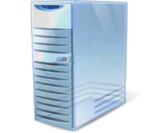
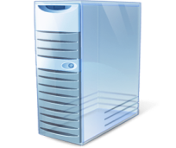

URL Filtering
Protect everywhere,
access anywhere
  Blocks malicious sites
  URL category sets and exclusions
  Integrated with forward proxy
  Backed by Microsoft Reputation Service (MRS)
Web server allows user to access the URL
User will able to access the URL
Web Server
TMG forwards the request to MRS
User requests the URL
5
MRS validates that the URL should or should not be allowed, per organizational policies
TMG sends a request to the Web server to get the URL
4
6
3
1
Microsoft Reputation Services
2
Managed / Unmanaged Endpoints
Reputation Providers

Slide 23






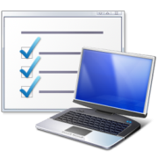



Intrusion Prevention System
Protect everywhere,
access anywhere
  Protects against known vulnerability-based threats at the edge of the network
  Provides same-day availability of patch and NIS signature
  Minimizes opportunities for exploits
    Closes the gap between vulnerability announcement and patch deployment on endpoints
Signature Updated
Access to Vulnerable Request Denied
Corporate User
1
6
2
3
4
5
MMPC Response Team
Vulnerability Research
Signature Development
Signature Testing
Signature Release

Slide 24
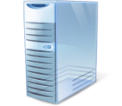





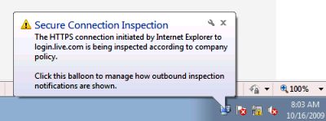
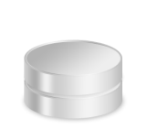

HTTPS Inspection
Protect everywhere,
access anywhere
  Protect your organization from security risks inherent to Secure Sockets Layer (SSL) tunnels, such as:
  Viruses and other malicious content that could infiltrate the organization undetected
  Users who bypass the organization’s access policy by using tunneling applications over a secure channel (for example, peer-to-peer applications)
HTTPS Settings
Certificate validation
Source exceptions
Destination exceptions
Client notification
Client initiates connection
TMG checks server certificate according to HTTPS inspection configuration
TMG makes SSL handshake with the client workstation
4
TMG makes SSL handshake with the destination server
Destination Server
1
3
Internet
Client
5
SSL Handshake using TMG’s Certificate
2
SSL Handshake using Destination Server’s Certificate
TMG reads configuration from storage via the configuration manager
Local Certificate Store

Slide 25

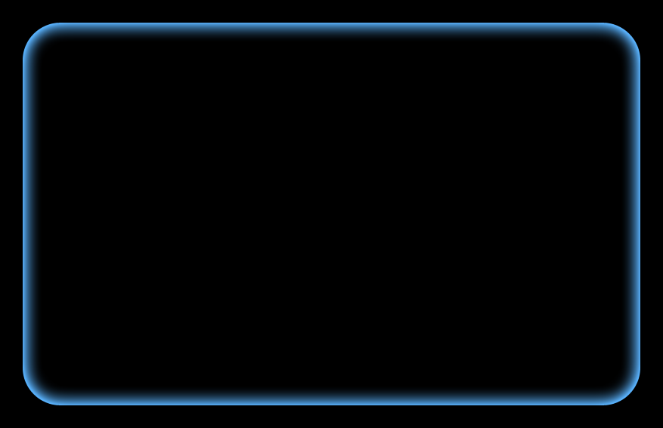

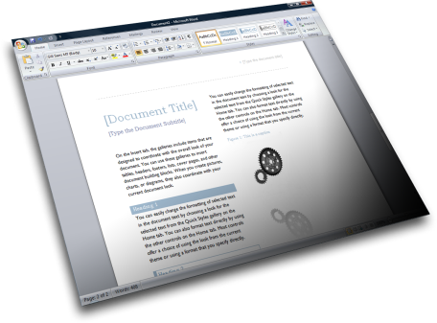
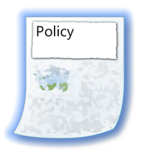





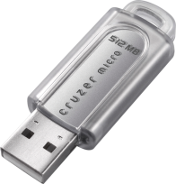


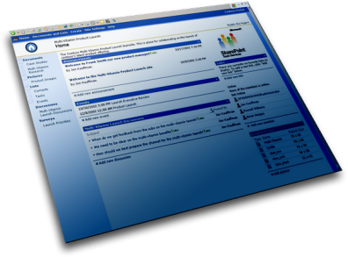

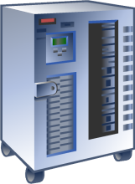




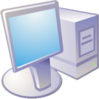
Protect Information Wherever it Goes or Resides
Protect everywhere,
access anywhere
1
2
3
Protection and policy stay with the document or e-mail
Protection and policy stay with the file or e-mail
Protection and policy stay with the file or e-mail
Policy
Policy
Policy
4
Policy
5
Policy
6
Policy
Archive stores file and policy in the clear
Portal protects file on access
Portal stores file in the clear

Slide 26






Rights-Protected Document Overview
Protect everywhere,
access anywhere
  Control access to content across the document lifecycle
  Allow only authorized access to documents based on user or group rights
  Secure transmission and storage of sensitive information within the document wherever it goes
  Provide a seamless end-user experience for reading protected content through automated key acquisition
Created when file is protected, encrypted with the Active Directory® Rights Management Services (AD RMS) server’s public key
Signed with the AD RMS server’s private key
Content Key
Publishing License
Usage Rights
Bob@fabrikam.com: Read, Print
Lawyers@fabrikam.com: Read
AD RMS Server
Contents of the file
(text, pictures, and so on)
AD RMS Client
Encrypted with content key
End User

Slide 27


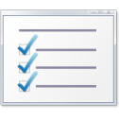







Protecting Documents
Protect everywhere,
access anywhere
  Help protect documents from unauthorized access
  Offer document-level encryption to secure information on the fly
  Prevent restricted content from being copied by using the Print Screen feature
  Support file expiration—content in a restricted e-mail cannot be viewed after a specified period of time
  Enable usage rights to be enforced after the information is accessed by an authorized user
7
1
AD RMS Server
8
2
6
5
9
3
4
Information Author
Recipient

Slide 28
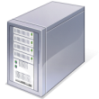


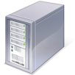
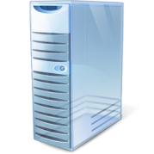




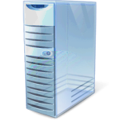
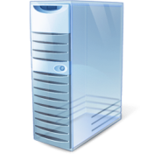
Windows DirectAccess
Protect everywhere,
access anywhere
  Provide seamless, always-on, secure connectivity to on-premises and remote users
  Eliminate the need to connect explicitly to the corporate network while remote
  Facilitate secure, end-to-end communication and collaboration
  Use a policy-based network access approach
  Enable IT to easily service, secure, update, and provision mobile machines—whether they are inside or outside the network
Intranet
Internet
Corporate
Resources
DirectAccess
Client
DirectAccess
Server
Internet Servers
Internal traffic
Internet traffic

Slide 29














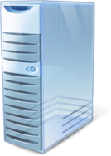



Seamless Access to Organizational Resources
Protect everywhere,
access anywhere
  Integrated SSL VPN capabilities
  Simplified remote access by non-Windows, down-level, or untrusted endpoints
  DirectAccess in Microsoft Windows Server® 2008 R2, along with Microsoft Forefront® Unified Access Gateway 2010, enable secure, seamless, always-on access to messaging and applications from Microsoft Windows® 7 clients
Data Center / Corporate Network
Microsoft Exchange
CRM
Microsoft SharePoint®
IIS based
IBM, SAP, Oracle
Mobile
Home / Kiosk
HTTPS / HTTP
Layer3 VPN
TS / RDS
Citrix
Internet
HTTPS (443)
DirectAccess
Non-Web
Business
Partners
AD, ADFS,
RADIUS, LDAP
Employees’
Managed Machines
NPS, ILM

Slide 30














UAG improves adoption and extends access to existing infrastructure
UAG is a hardened-edge appliance available in HW and virtual options
UAG enhances scale and management with integrated
LB and array capabilities
UAG provides access for
down-level and non-Windows clients
UAG uses wizards and tools to simplify deployments and ongoing management
Unified Access Gateway and DirectAccess: Better Together
Extends access to line-of-business servers with IPv4 support
Protect everywhere,
access anywhere
Provides access for down-level and non-Windows clients
Enhances scalability and management
Simplifies deployment and administration
{
Delivers a hardened-edge solution
Windows Server 2008 R2
Managed
Windows 7
Windows Server 2008 R2
Always On
Windows 7
IPv6
Windows Server 2008 R2
IPv6
SSL-VPN
{
Windows Server 2003
Windows Vista/ Windows XP
Legacy Application Server
Unmanaged
Non-Windows
DirectAccess Server
+
Non-Windows Server
SSL-VPN
IPv4
PDA
IPv6
or
IPv4

Slide 31
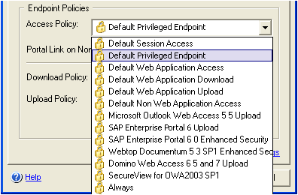





Endpoint Health Assessment
Protect everywhere,
access anywhere
  Out-of-the-box support for more than 70 variables
  of detection, including antivirus, anti-malware,
  and personal firewall
  Easy-to-configure GUI to simplify management
  of endpoint detection policies
  Extended GUI for manually editing policies
  Windows Shell Scripting for creating policies
  and inspecting for client-side variables
Non-Compliant Endpoint
Access Denied
Corporate
Resources
Compliant Endpoint
Access Allowed

Slide 32
INTEGRATE and
EXTEND Security

Slide 33


Integration with Infrastructure
Integrate and extend
security
Windows | Filter Manager: Promotes stable performance, scans for viruses and spyware in real time Support for Transactional NTFS: Efficiently handles errors and protects data, uses Windows Image File (WIM) for hard drive imaging
Active Directory | Single policy configures antivirus, anti-spyware, and state assessment Forefront Client Security console is integrated with Active Directory for easy policy deployment Policy also can be deployed via Group Policy management console or through third-party software distribution systems
Operations Manager (Embedded) | Provides real-time alerting and reporting Event Flood Protection shields the reporting infrastructure during an outbreak from infected clients
Notes:
33

Slide 34


Prevent Data Loss or Theft
Integrate and extend
security
  Microsoft BitLocker®
  BitLocker Drive Encryption –
  Windows Volume
  Trusted Platform Module (TPM)
  to protect data
  Integrity check of Windows boot files
  Pre-OS multi-factor authentication
  AES 128-bit or AES 256-bit
  key encryption
  Store recovery information in Active Directory for manageability
  Microsoft BitLocker-To-Go™
  Data protection for removable storage devices such as USB
  flash drives
  Enhanced data protection against data theft and exposure through easy-to-use encryption technology
  Provides read-only support for removable devices on older versions of the Windows operating system

Slide 35

Prevent Unauthorized Access to Information
Integrate and extend
security
  Windows Device Control
  Prevent installation of
  prohibited devices
  Configure policies to allow administrators to override
  device installation restrictions
  Control read and write permissions
  for removable media
  Microsoft AppLocker™
  Prevent unlicensed software from running in the desktop environment
  Help to ensure that the desktop environment is in compliance with corporate policies
  AppLocker rules can be associated with a specific user or group

Slide 36






Network Access Protection
Integrate and extend
security
  Health state validation against health requirement policies
  Health policy compliance with health requirement policies
  Limited access to compliant computers until updates and configuration changes are completed
Microsoft Forefront® Client Security (FCS): managed machines attempting to connect to the network
If the endpoint does not comply, the policy is redirected to the remediation server to update
Microsoft Network Policy Servers (NPS)
Restricted Network
Remediation Servers
(such as WSUS)
1
4
Not Policy Compliant
2
Policy Compliant
UAG as a Network Access Protection (NAP) client checks to ensure that the FCS agent is up-to-date and actively protecting clients
3
If the endpoint has FCS running and is up-to-date, access to the corporate network is allowed
Corporate Network
Health Policies
(for example, patch-level, AV signature version)

Slide 37


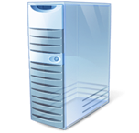



Deploying Updates
Integrate and extend
security
  Signature deployment optimized for Windows Server Update Services (WSUS):
  Can use any software distribution system
  Automatic and manual approval of definitions
  Forefront Client Security installs an Update Assistant Service:
  Increases sync frequency between WSUS and Microsoft Update for definitions
  Support for roaming users:
  Failover from WSUS to Microsoft Update
Sync
Sync
®
Malware Research
Microsoft Update
WSUS +
Update Assistant
Desktops, Laptops and Servers
Notes:
5/22/2012 11:11 AM
37

Slide 38
SIMPLIFY Security,
MANAGE Compliance

Slide 39
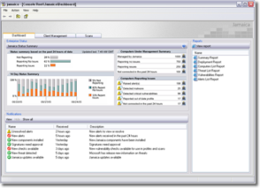

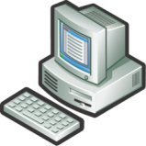

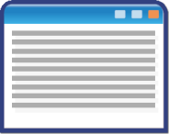


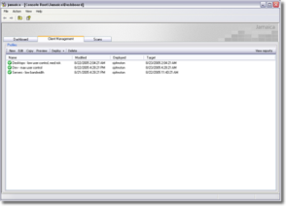
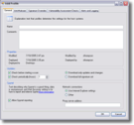
Single Policy Security Management
Simplify security,
manage compliance
  Single agent security management from threats
  One console for simplified security administration
  One policy to manage client protection agent settings
  Customized Forefront Client Security
  Specifies threat response
  Keeps security systems up-to-date
Forefront Client Security Console
Administrator creates
and deploys policy
Clients
Group Policy
Management Console

Slide 40
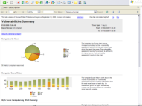




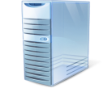
Security State Assessment
Simplify security,
manage compliance
  Defined industry best practices and known vulnerabilities
  Security State Assessment (SSA)-based reporting functionality to measure security risk profiles
  Use SSA checks to search for potential vulnerabilities
  Examine data from the registry, file system, WMI, IIS metabase, SQL, and more
  Detect common vulnerabilities in the environment and configuration
Reporting and
Alerting Server
Client Computers
State Assessment Summary

Slide 41
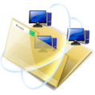



Manage Compliance
Simplify security,
manage compliance
  Enforce enterprise policy to protect from unauthorized access
  Boost security by reducing the risk of information leaks through persistent protection of data
  Streamline adoption and deployment with out-of-the box integration with collaboration workflow, Microsoft Office, and Active Directory
  Single engine enhances client machine performance and detection capabilities
  Advanced malware removal and cleaning scripts help to ensure that the machine is still in a usable state
  Centralized initiation of scanning across the enterprise helps to protect from threats
  Dashboard and risk-centric prioritized view throughout the enterprise
  Centralized reporting and alerting with UAG Management Console
  Access to SharePoint sites and the ability to edit documents from virtually anywhere (managed laptops, home computers, kiosks, and mobile devices)
  URLs are examined for compliance with corporate policy and for malicious potential of the destination Web site
  Single console for configuring and viewing the security states of all organizational endpoints

Slide 42
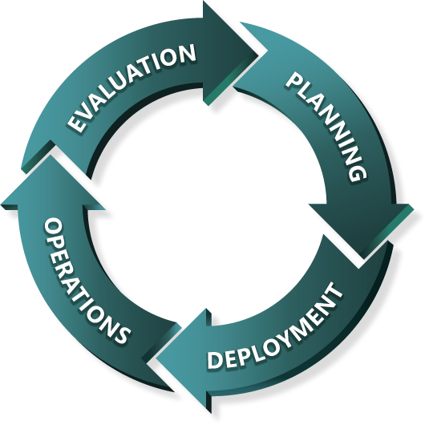
Getting Started
Hands-on Labs and VMs
Architecture, Planning, and Design Guides
Evaluation Guides
Infrastructure Planning Guides
Proof of Concepts
Information Protection Using Rights Management Services
Operations Guides
Forefront Endpoint Protection Deployment
Administrator Guides
Troubleshooting Guides
Secure Web Access

Slide 43
Secure Endpoint
Protect client and server operating systems from emerging threats and information loss, while enabling more secure access from virtually anywhere
PROTECT everywhere
ACCESS anywhere
INTEGRATE and
EXTEND security
SIMPLIFY security,
MANAGE compliance
  Advanced malware protection
  Protect sensitive information
  Secure, always-on access
  Integrated with OS security
  Leverages existing infrastructure
  Simplified management
  Enterprise-wide visibility
Learn more at: www.microsoft.com/forefront

Slide 44












IT越来越大的压力
技术更新
服从规则
竞争
安全
保持企业更好的
运转
降低成本
最终用户生产力
联系客户
商业成果
& 新的价值

Slide 45
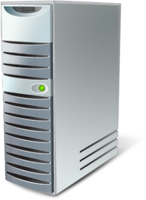

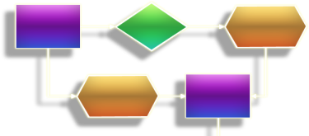




动态 IT
统一化
与虚拟化
流程导向
模型驱动
面向服务
面向用户
联合 互操作 安全
Notes:
基础架构优化：基本型、标准型、合理性、动态型

Slide 46




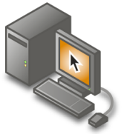
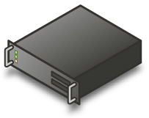







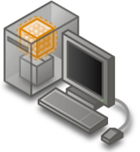
统一化与虚拟化
表示层虚拟化
服务器虚拟化
管理
桌面虚拟化
应用程序虚拟化

Slide 47
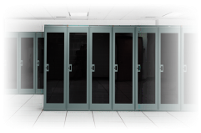






下一代动态 IT
安全与可信赖平台
虚拟化
下一代Web
最佳决策
虚拟化
企业级数据平台
富Web平台
富客户端平台
Web
超越关系型数据库
开发效率
安全
动态开发
团队协作
坚固基础
提升业务洞察力
支持最新平台

Slide 48











构建动态IT系统的基础
全新的Windows Server 2008产品家族
中型企业
大型企业
小型企业
高性能
计算
Web托管
存储
分支机构

Slide 49

革命性的服务器平台—Windows Server 2008
管理
Server Manager
PowerShell
WDS
群集
Server Core
安全
BitLocker
RMS
增强防火墙
RODC
NAP
虚拟化
服务器虚拟化
应用程序虚拟化
桌面虚拟化
表示层虚拟化
集中管控
Web
SharePoint Services
IIS7.0
PowerShell
Windows Media Services

Slide 50









Windows Server 2008 设计目标
Web
虚拟化技术
安全性
极具效率和丰富用户体验的Web服务平台
降低成本，提高硬件利用率，优化服务器基础架构并提高其可用性
为您的网络、数据以及业务提供的全面完善的安全保护
为您的业务提供坚实的系统支持
迄今为止最可靠以及最具灵活性的Windows服务器操作系统
为您的业务需求量身定制的Windows服务器操作系统，
功能全面，系统可靠

Slide 51

迄今为止最可靠和最灵活的
Windows Server 操作系统
坚实的基础
管理
可靠性
Windows Server Manager
PowerShell
Windows 管理服务
服务器核心 （Server Core）
下一代的网络架构
增强的高可用性解决方案

Slide 52

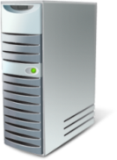

对分公司带来的好处
Solid Foundation
优化
  SysVol Replication
  DFS Replication
  协议
安全
  BitLocker
  服务器核心
  只读域控制器
  角色分离
管理
  打印管理控制台
  PowerShell, WinRS, WinRM
  虚拟化
  可重新启动的活动目录
Hub Site
Branch Office

Slide 53



故障转移群集
Solid Foundation
Node
A
Node
B
Active Node
Heartbeat
Passive Node
新的确认向导，更简单，更灵活
支持使用GPT磁盘作为群集共享存储
增强的群集安装和迁移工具
增强的稳定性和安全性– 彻底排除无单独故障点
支持IPv6
全面支持地理分布群集

Slide 54

优化你的基础架构，提高服务器的可用性
虚拟化
Terminal Services RemoteApp
Windows Server Virtualization
Terminal Services Gateway

Slide 55







虚拟化技术
Virtualization
服务器虚拟化
展现层虚拟化
Windows Server Virtualization
虚拟化
Management
桌面虚拟化
应用程序虚拟化

Slide 56


应用程序虚拟化
Virtualization
应用程序隔离
动态下载，按需运行
和System Center完全集成
集中管理，实现 Software as Service
通过MDOP获得

Slide 57



















Virtualization Investments
Virtualization
A Multi-level Approach
Licensing
Infrastructure
Management
Interoperability
Applications
Terminal Services
Deliver
cost-effective, flexible and simplified licensing
Royalty Free VHD format
Create agility
Better utilize
server resources
Partner with AMD and Intel
Ease consolidation
onto virtual infrastructure
Better utilize
management
resources
Support
heterogeneity
across the
datacenter
OSP (Open Specification Promise) VHD
Accelerate
deployment
Reduce the cost of supporting
applications

Slide 58

使操作系统更加牢固及提高安全环境
Network Access Protection
安全性
Read-Only Domain Controller
Federated Rights Management

Slide 59


网络访问保护
Security
Policy Servers
such as: Patch, AV
What is Network Access Protection?
良好的策略确认
良好的策略标准
Not policy compliant
Remediation
Servers
Example: Patch
Windows
Client
DHCP, VPN
Switch/Router
NPS
Restricted
Network
提供限制连接的能力
Policy compliant
增加安全性
Corporate Network
增加企业价值
Cisco and Microsoft Integration Story

Slide 60


只读域控制器
Security
RODC
Main Office
Branch Office
特征
  只读的活动目录数据库
  仅允许用户密码保存在RODC上
  单向复制
  角色隔离
好处
  当对那些安全得不到保障的物理控制器提高安全性
支持
  ADFS,DNS, DHCP, FRS V1, DFSR (FRS V2), Group Policy, IAS/VPN, DFS, SMS, ADSI queries, MOM

Slide 61




活动目录证书服务
Security
安全
管理性
互用性
下一代的密码技术
Windows Server 2008 服务器角色
OCSP Support
细化的管理
PKIView
IDP CRL Support
V3 证书
New GPOs
MSCEP Support

Slide 62

PKI增强
Security
企业版 PKI (PKIView)
Now a Microsoft Management Console snap-in
对Unicode字符集的支持
Online Certificate Status Protocol (OSCP)
在线反馈
反馈队列
网络设备登记服务
Microsoft's implementation of the Simple Certificate Enrollment Protocol (SCEP)
使用IPsec来增加交流安全性
Web登记
移除先钱的ActiveX® 注册控件- XEnroll.dll
增加新的COM 注册控件 - CertEnroll.dll

Slide 63

下一代加密技术
Security
Cryptography Next Generation (CNG)
包括新的加密算法, 数字签名, 关键交换, 及散列法
支持在核心模式下加密
支持目前CryptoAPI 1.0 算法
支持elliptic curve cryptography (ECC) 算法
执行简单加密操作，比如创建散列法及编码及解码

Slide 64






部署技术产品路线图
SMS
2003
SMS 2003
OSD FP
SCCM 2007
CCM 2007 with
WDS Integration
ADS 1.0
VSMT
ADS 1.1
RIS in Windows Server 2003
WDS in Windows Server 2003
WDS in Windows
Server 2008
Windows Vista Client Timeframe
Windows Server 2008 Timeframe & Beyond
CY 2003
2004
2005
Notes:
64

Slide 65





组件构成
Windows Server 2008
  部署服务器
Windows Vista SP1
Windows Server 2008
WDS客户端
网络环境

Slide 66





WDS部署方案
参考样机
WDS服务器
Notes:
WDS部署方案：
介绍企业使用WDS服务用于部署操作系统的工作流程，向听众展示WDS的功能
在企业使用WDS服务器进行操作系统大规模部署时，首先要制作一台参考样机，在参考样机上安装必要的应用程序，并进行必要的设置
在安装完成参考样机后，使用WDS服务器抓取参考样机成为映像，并传送映像到WDS服务器上
之后使用WDS服务器进行操作系统的大规模部署

Slide 67
革命性的服务器平台—Windows Server 2008
管理
Server Manager
PowerShell
WDS
群集
Server Core
安全
BitLocker
RMS
增强防火墙
RODC
NAP
虚拟化
服务器虚拟化
应用程序虚拟化
桌面虚拟化
表示层虚拟化
集中管控
Web
SharePoint Services
IIS7.0
PowerShell
Windows Media Services

Slide 68








Windows Vista and Windows Server 2008
Better Together
更有效的管理
全球单一服务模式
在客户和服务器之间转交事件
更快及更可靠的操作系统部署
网络连接保护确保了良好的系统连接率
更好的可用性
可升级打印服务器with client-side rendering
顺畅的脱机体验with client-side caching
文件的交易系统和注册操作
基于策略的质量服务安排应用程序带宽
高效沟通
在客户端和服务器上快速查找企业分类
通过新的TCP/IP堆栈和本地IPv6，加快网络速度
通过更多的连接来改进文件共享成效
用远程连接整合内部的应用程序和资源

Slide 69







Windows Server Roadmap
2009
2008 R2
2008
“Cougar”
2008
2008 RTM
2008 Beta 3
2007

Slide 70


























创新永无止境
今天

Slide 71

© 2010 Microsoft Corporation. All rights reserved. Microsoft, Windows, Windows Vista and other product names are or may be registered trademarks and/or trademarks in the U.S. and/or other countries.
The information herein is for informational purposes only and represents the current view of Microsoft Corporation as of the date of this presentation. Because Microsoft must respond to changing market conditions, it should not be interpreted to be a commitment on the part of Microsoft, and Microsoft cannot guarantee the accuracy of any information provided after the date of this presentation.
MICROSOFT MAKES NO WARRANTIES, EXPRESSED, IMPLIED OR STATUTORY, AS TO THE INFORMATION IN THIS PRESENTATION.
Notes:
71

